Slide 1
Book for the slides
1) Introduction to Data Mining
Author: P N Tan, M Steinbach and V Kumar
2) Data Mining: Concepts and Techniques
Author: J Han and M Kamber

Slide 2
Rule-based classifier
is a technique for classifying records using a collection of “if…then…” rules.
Rules for the model are represented in a disjunctive normal form
R = (r₁ ∨r₂ ∨ … r_{k} )
where R is the rule set and r_{i} ‘s are the classification rules or disjuncts
Table. 5.1
Example of a rule set for the vertebrate classification problem
r1: (Gives Birth = no) ∧ (Aerial Creature = yes) → Birds
r2: (Gives Birth = no) ∧ (Aquatic Creature = yes) → Fishes
Left hand side is called antecedent or precondition
Right hand side is called rule consequent
Bayesian Classifiers
The relationship between the attribute set and the class variable is non-deterministic
The class label of a test record cannot be predicted with certainty even though its attribute set is identical to some of the training records
This situation may arise because of noisy data or the presence of certain confounding factors that affect classification but are not included in the analysis

Slide 3
Bayesian Classifiers …
The approach for modeling probabilistic relationships between the attribute set and the class variable is represented with the help of Bayes theorem .
Bayes theorem
It is a statistical principle for combining prior knowledge of the classes with new evidence gathered from data
Two implementations of Bayesian classifiers:
  Naïve Bayes
  Bayesian belief networks
Naïve Bayesian Classifiers
Let X and Y be a pair of random variables
The joint probability
P(X=x, Y = y) refers to the probability that variable X will take on the value of x and variable Y will take on the value y.
P(X,Y) = P(Y|X) × P(X) = P(X|Y) × P(Y)

Slide 4
Rearranging the last two expressions, we get the Bayes theorem:
P(Y|X) = P(X|Y) P(Y) / P(X)
Both X and Y can take on the values from the set::
  Probability Team 0 wins is P(Y=0) =0.65
  Probability Team 1 wins is P(Y=1) = 1 – P(Y=0) = 1 - .65 = 0.35
We need to compute P(Y=1 | X=1) = 0.5738
Bayes Theorem for Classification
Let X denote the attribute set and Y denote the class variable
If X and Y are random variables, we can capture their relationship probabilistically using P(Y|X)- conditional probability, or posterior probability for Y where prior probability is P(Y).
e.g., Task of predicting whether a loan borrower will default on their payments
If P(Yes|X) > P(No|X), then the record is classified as Yes, otherwise it is classified as No.

Slide 5
Classification
Naïve Bayes Classifier
A naïve Bayes classifier estimates the class-conditional probability by assuming that the attributes are conditionally independent, given the class label y.
Conditional Independence assumption
Conditional Independence

Slide 6
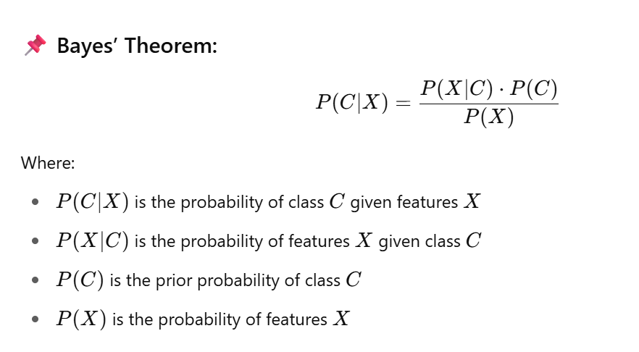
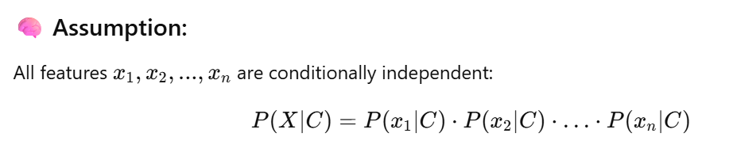
The Naive Bayes algorithm is a simple and effective probabilistic classifier based on Bayes’ Theorem, with the strong assumption that all features (attributes) are independent of each other given the class label (which is why it is called “naive”).
It is widely used in classification problems like spam detection, sentiment analysis, and document categorization.

Slide 7
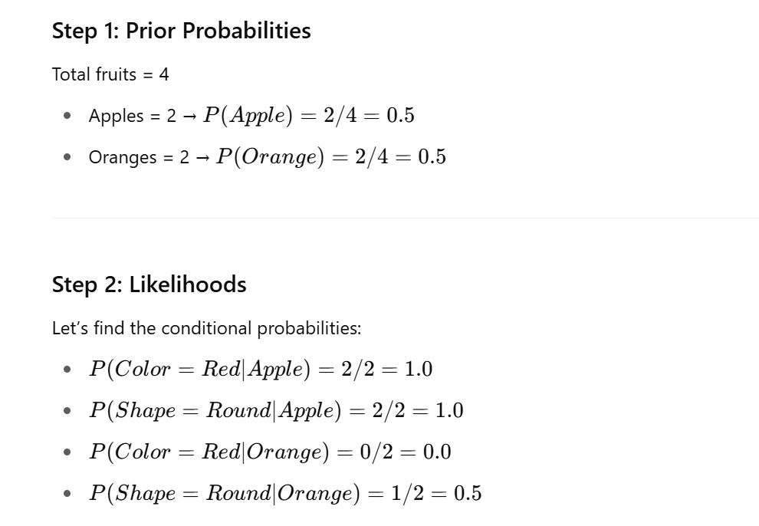
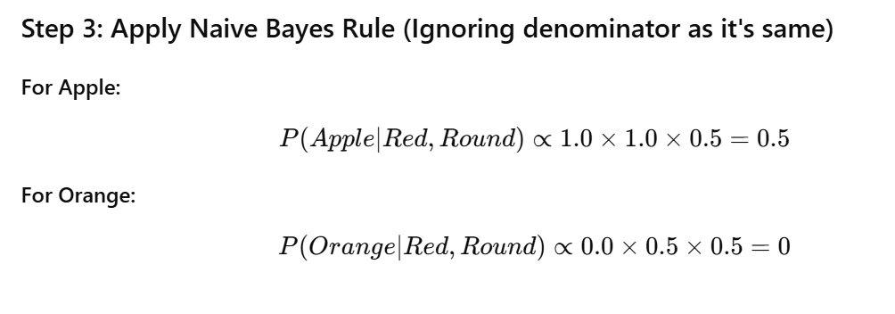
Fruit | Color | Shape
Apple | Red | Round
Apple | Red | Round
Orange | Orange | Round
Orange | Orange | Oval

